Slide 1
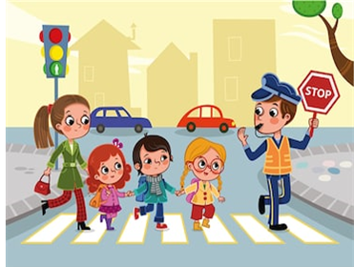
SCHOOL CROSSING GUARD APPRECIATION DAY March 20th, 2019
My Crossing Guard is the best because

